Slide 1
Chapter 8
The Client-Server Model – Section 2

Slide 2
Overview - 1
Echo Example:
  Client-Server using Connectionless Datagram (UDP socket).
  Client-Server using Stream-mode socket (TCP socket).
Iterative and Concurrent Servers (Single Threaded and Multiple Threaded servers)
Stateless Servers.
Stateful Servers:
  Global state information.
  Session state information.

Slide 3
Echo Service - 1
Allows a client to send one text line to the server at a time, receiving an echo of each line from the server.
Typically Usage - Default echo server (port 7) on any internet host can be used as a temporary surrogate server when a s/w engineer is developing a client for another protocol.
RFC: http://tools.ietf.org/html/rfc862+echo&ct=clnk
Involves multiple rounds of data exchange between client and server.

Slide 4
Echo Service - 2
We will examine two versions:
  Client-Server using Connectionless Datagram (UDP socket I.e. connectionless datagram socket).
    Sessions with multiple clients can be interleaved
  Client-Server using Stream-mode socket (TCP socket I.e. stream mode socket – connection-oriented).
    Sessions with concurrent clients can only be sequential unless the server is threaded

Slide 5
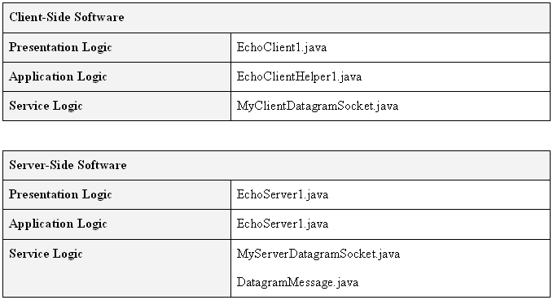
Echo Service – C/S Connectionless Datagram (UDP socket)
Note: Service logic files same as Daytime.

Slide 6
EchoServer1 (Conectionless)
public class EchoServer1 {
public static void main(String[] args) { …
// instantiates a datagram socket for both sending
// and receiving data
MyServerDatagramSocket mySocket = new MyServerDatagramSocket(serverPort);
while (true) { // forever loop
DatagramMessage request = mySocket.receiveMessageAndSender();
String message = request.getMessage( );
    mySocket.sendMessage(request.getAddress( ),
request.getPort( ), message); } //end while
}

Slide 7
Excerpt from Client
public class EchoClient1 {
static final String endMessage = ".";
public static void main(String[] args) {
EchoClientHelper1 helper =
new EchoClientHelper1(hostName, portNum);
echo = helper.getEcho( message);

Slide 8
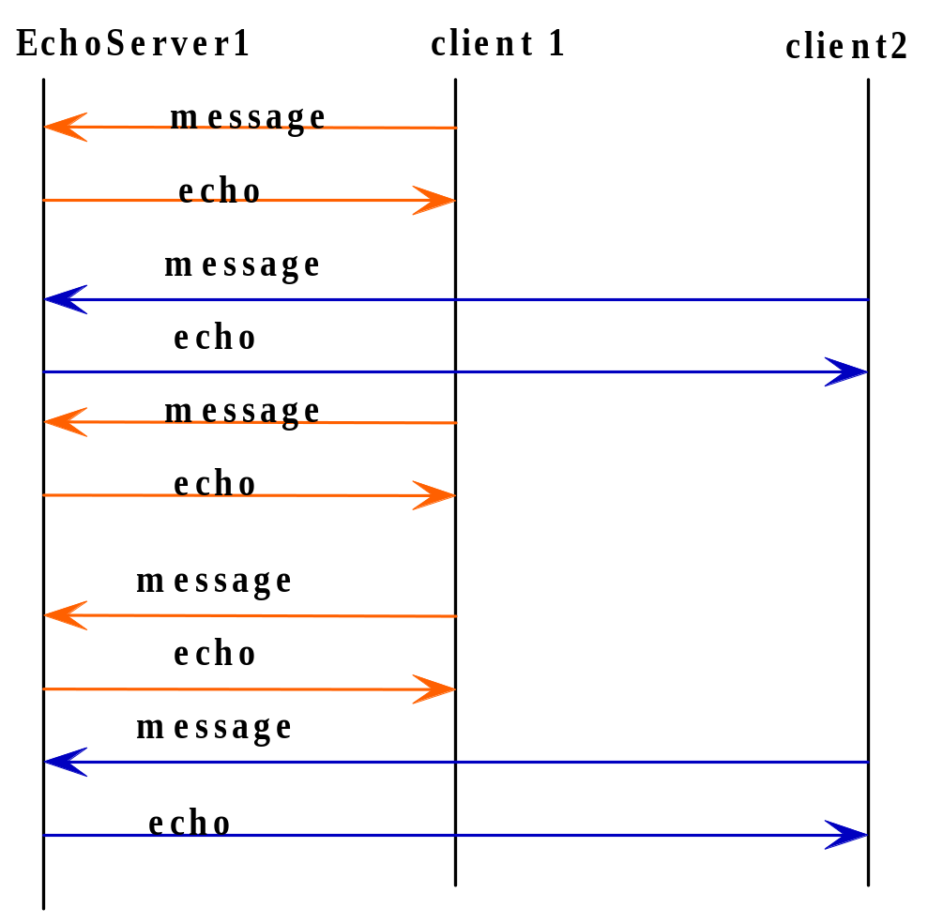
Sequence Diagram - Echo1
It IS possible for the server to interact with different clients in successive iterations.
How? No connection.
Result is interleaved concurrent service sessions.

Slide 9
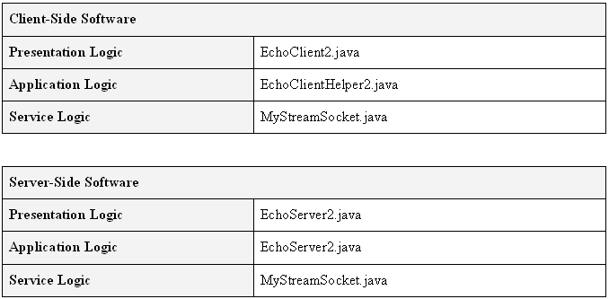
Echo Service - C/S Stream-mode
(TCP socket).
Note: Service logic files same as Daytime.

Slide 10
EchoServer2 (Connection-oriented)
ServerSocket myConnectionSocket = new ServerSocket(serverPort);
while (true) { // forever loop
MyStreamSocket myDataSocket = new MyStreamSocket
(myConnectionSocket.accept( ));
boolean done = false;
while (!done) {
message = myDataSocket.receiveMessage( );
if ((message.trim()).equals (endMessage)){
      myDataSocket.close( );
done = true;
} //end if
else {
      myDataSocket.sendMessage(message);
} //end else
} //end while !done
} //end while forever

Slide 11
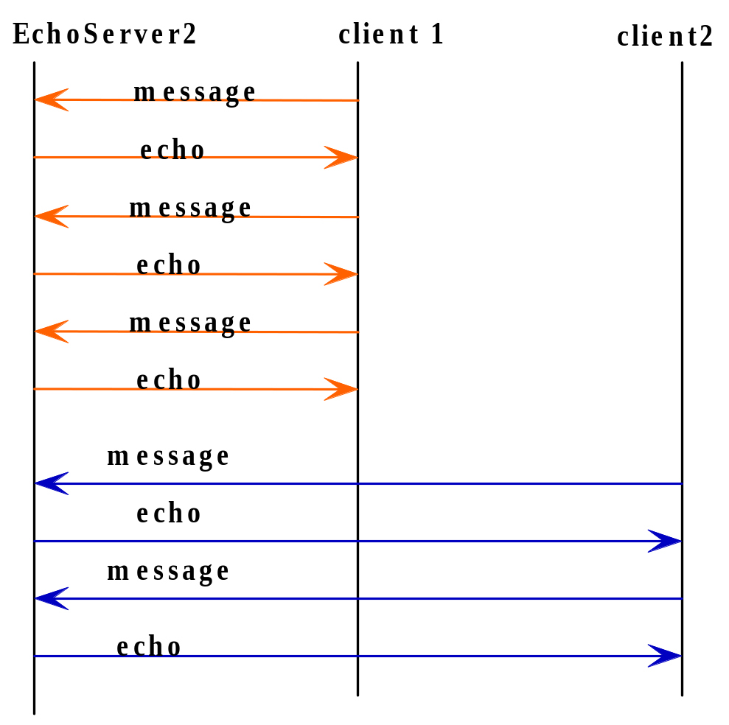
Sequence Diagram – Echo2
During session – server maintains its connection with the client via a data socket dedicated to the client.
If another client attempts to connect to the server while occupied with a session client will NOT be able to exchange data with server until server is finished with current session(i.e. client)
Unless threading is used.
End of client 1 session
Start of session 2

Slide 12
Two consecutive client sessions with echo server2

Slide 13
Iterative V’s Concurrent Server - 1
Terms single-threaded and multi-threaded are also used.
With a connection-oriented server (i.e. TCP) there is no overlapping of client sessions.
Server is limited to exchanging data with a client whose connection it has accepted.
Called an iterative server – serves one client at a time.

Slide 14
Iterative V’s Concurrent Server - 2
The client will be blocked until all preceding clients have been served – not desirable.
Use a concurrent server, that is, a server capable of conducting multiple client sessions in parallel.
A concurrent server is implemented using:
  Threads
  OR
  Asynchronous IPC operations

Slide 15
Concurrent Server using Threads - 1
A concurrent server uses a single connection socket to listen for connections (as with iterative/single threaded server).
Server creates a new thread to accept each connection and conduct a service session with the connected client.
Thread terminated when session is finished.

Slide 16
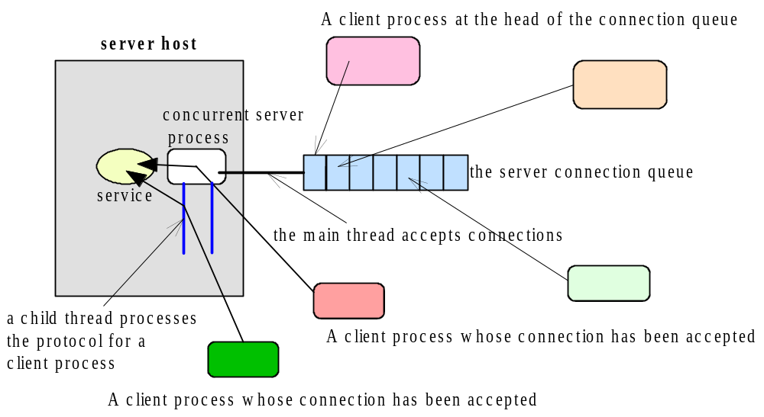
A Concurrent, Connection-oriented Server

Slide 17
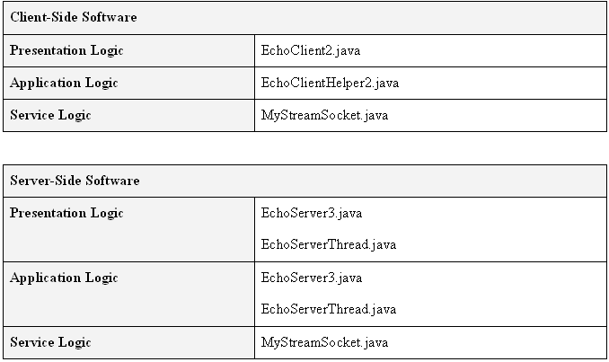
Concurrent Echo Server - Threads
EchoClient2 can be used to access EchoServer3.
Run() method in thread implements client logic session.

Slide 18
EchoServer3 (concurrent) excerpt
ServerSocket myConnectionSocket =
new ServerSocket(serverPort);
while (true) { // forever loop
MyStreamSocket myDataSocket = new
MyStreamSocket
(myConnectionSocket.accept( ));
Thread theThread =
new Thread(new
ServerThread(myDataSocket));
theThread.start();
} //end while forever

Slide 19
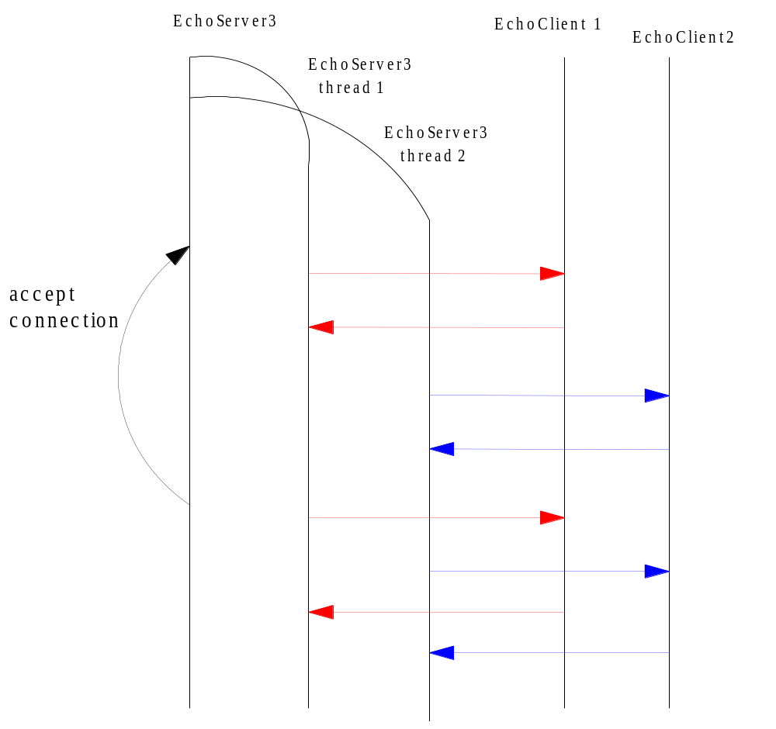
Sequence Diagram – EchoServer3

Slide 20
ServerThread.java excerpt
(Note: See Liu – Figure 5.29 for EchoServerThread code.)
class ServerThread implements Runnable {
static final String endMessage = ".";
MyStreamSocket myDataSocket;
ServerThread(MyStreamSocket myDataSocket)
{
this.myDataSocket = myDataSocket;
}
public void run( ) {
boolean done = false;
String message;
try {
while (!done) {
message = myDataSocket.receiveMessage( );
if ((message.trim()).equals (endMessage)){
myDataSocket.close( ); done = true;
} //end if
else {
myDataSocket.sendMessage(message);
} //end else
} //end while !done
}// end try
catch (Exception ex) {
System.out.println("Exception caught in thread: " + ex);
} //end run } //end class

Slide 21
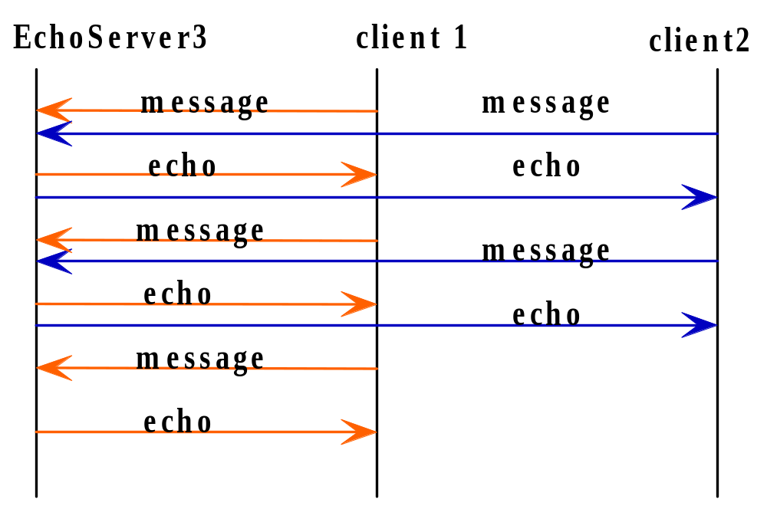
Echo3Server concurrent sessions

Slide 22
Stateful vs. Stateless Servers - 1
A server that does not maintain state information in order to provide its service is a stateless server
Provides its service according to a stateless protocol.
Example(s):
  Daytime – server sends timestamp.
  Echo – server echoes each message it receives.
Task being performed is independent of state.

Slide 23
Stateful V’s Stateless Servers - 2
For some protocols or applications, a server must maintain information specific to a client during its service session
Provides its service according to a stateful protocol.
A stateful server maintain stateful information on each active client.
Stateful information can reduce the data exchanged, and thereby the response time

Slide 24
State Information
Information that is stored by the server as it conducts a session with a client(s).
For example, we need to store the IP address of the client.
There are two types of state information:
  Global state information.
  Session state information.

Slide 25
Global State Information - 1
Information that is maintained by the server for all the clients throughout the lifetime of the server.
Example:
  Counter protocol – not a standard internet protocol.

Slide 26
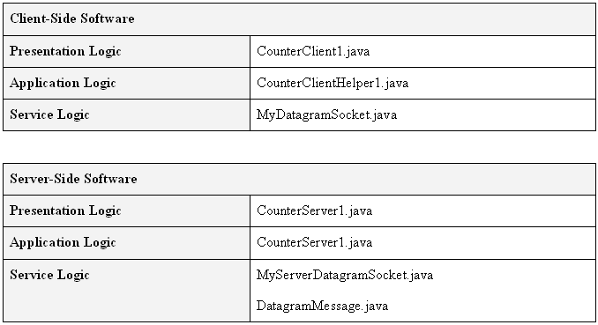
Global State Information - 2

Slide 27
Session State Information
Information that is maintained by the server specific to a client session.
Examples:
  FTP- file is typically transferred in blocks, requiring several rounds of data exchanges to complete the file transfer.
  Shopping Cart application – shopper identity and basket contents.
There are at least two schemes that can be used to maintain the session state data:
  Stateless server (use cookies on client to store state)
  Stateful server.

Slide 28
Stateless Server
Session state information is maintained by the client.
Each request contains the session state information.
Allows the server to service each request in accordance with the state data sent in the request.
    Client: Please send me block 1 of the file foo in directory someDir.
    Server: Okay. Here is that block of the file.
    Client: Please send me block 2 of the file foo in directory someDir
    Server. Okay. Here is that block of the file
    …
    Client. Please send me block n of the file foo in directory someDir
    Server: Okay. Here is that block of the file.

Slide 29
Stateful Server
Session state information is maintained by the server.
Dialog might proceed as follows:
    Client: Please send me the file foo in directory someDir.
    Server: Okay. Here is block 0 of the file foo.
    Client: Got it.
    Server. Okay. Here is block1 of the file
    Client: Got it.
    …
    Server. Okay. Here is blockn of the file
    Client: Got it.

Slide 30
Stateless V’s Stateful Servers
Stateless servers allows the server to process each request in the same manner.
Reduces the complexity of the application logic.
Stateful servers:
  More complex to design and implement.
  State information must be safeguarded should the session be disrupted.
Implementation: server can be stateless, stateful or a hybrid.

Slide 31
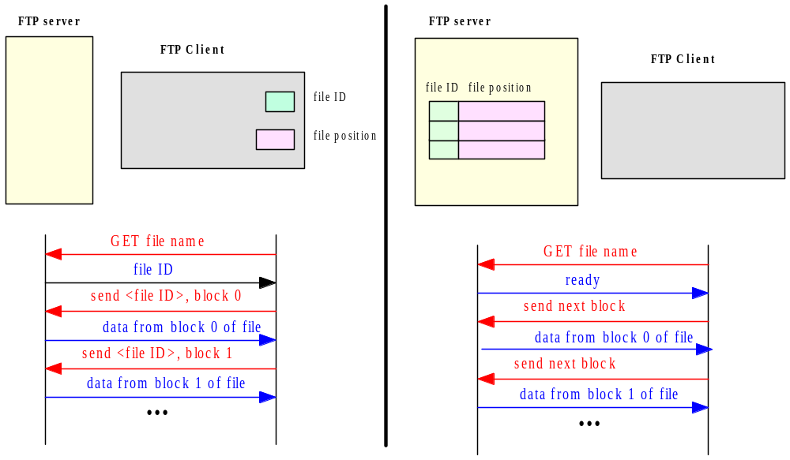
Stateless V’s Stateful Servers - FTP
Stateless Server
Stateful Server

Slide 32
Review - 1
Echo Example:
  Client-Server using Connectionless Datagram (UDP socket).
  Client-Server using Stream-mode socket (TCP socket).
Iterative and Concurrent Servers (Single Threaded and Multiple Threaded servers)
Stateless Servers.
Stateful Servers:
  Global state information.
  Session state information.

Slide 33
Chapter Review - 1
Difference between the client-server system architecture and the client-server distributed computing paradigm.
Definition of the paradigm and why it is widely adopted in network services and network applications.
The issues:
  Service sessions.
  Protocols.
  Service location.
  Inter-process communications.
  Data representation and event synchronization in the context of the client-server paradigm.

Slide 34
Chapter Review - 2
The three-tier software architecture of network applications:
  Presentation logic
  Application logic
  Service logic.
Connectionless server versus connection-oriented server.
Iterative server versus concurrent server and the effect on a client session.
Stateful server versus stateless server.
In the case of a stateful server: global state information versus session state information.

